Slide 1
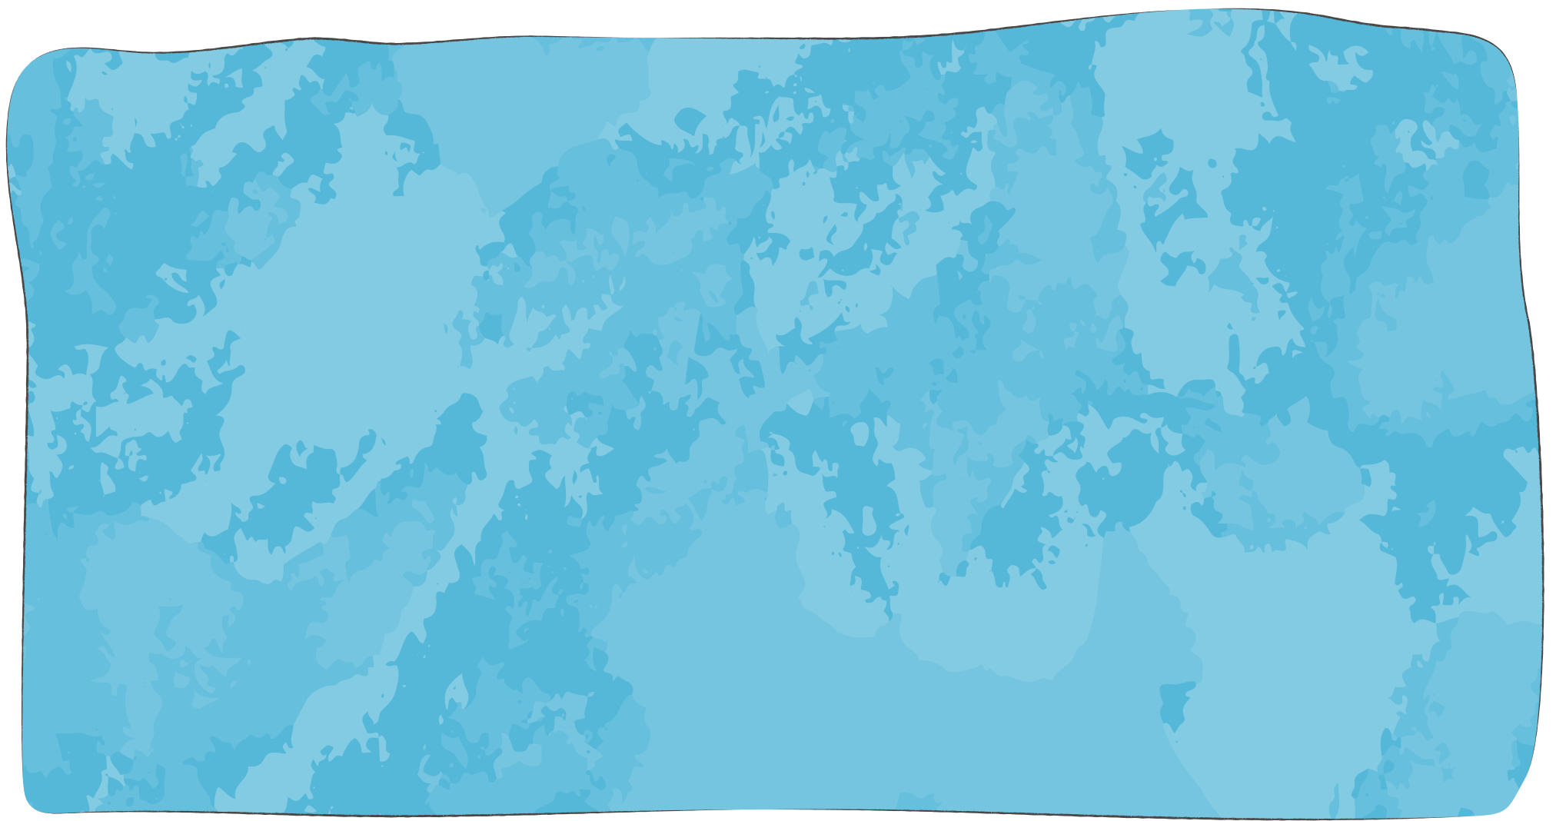
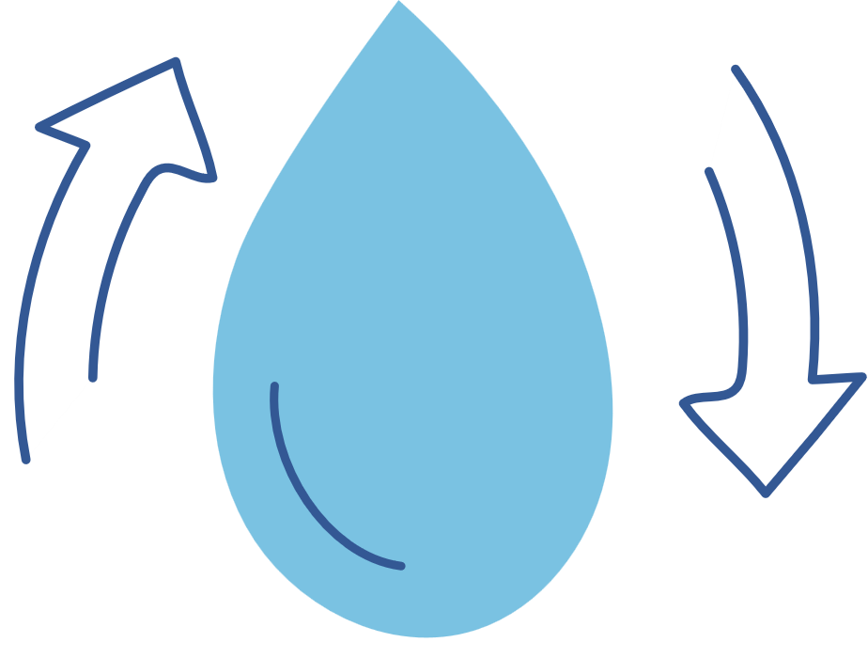
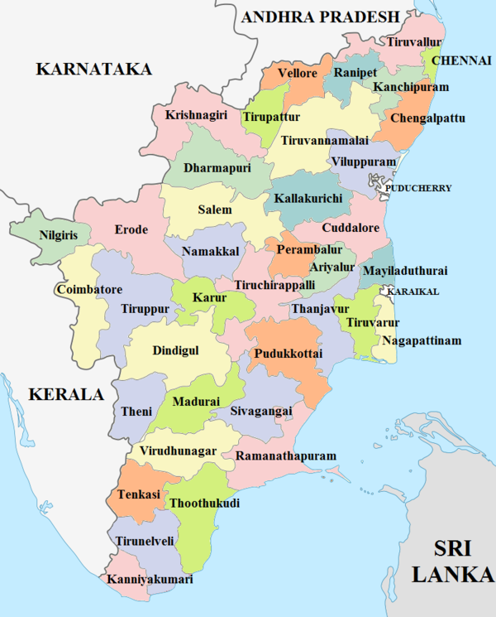

Analysis of Ground Water Quality Dynamics in Tamil Nadu Using Machine Learning and Spatial Associations

Slide 2

Groundwater
The water stored beneath the Earth's surface in soil pores and rock formations.
Uses:
Drinking water supply
Agricultural irrigation
Industrial processes
Groundwater Recharge

Slide 3

Collection of Dataset
Central Ground Water Board (CGWB).
Three years 2019, 2020, 2021.
2019 --> 1177 wells.
2020 --> 112 wells.
2021 --> 612 wells.

Slide 4
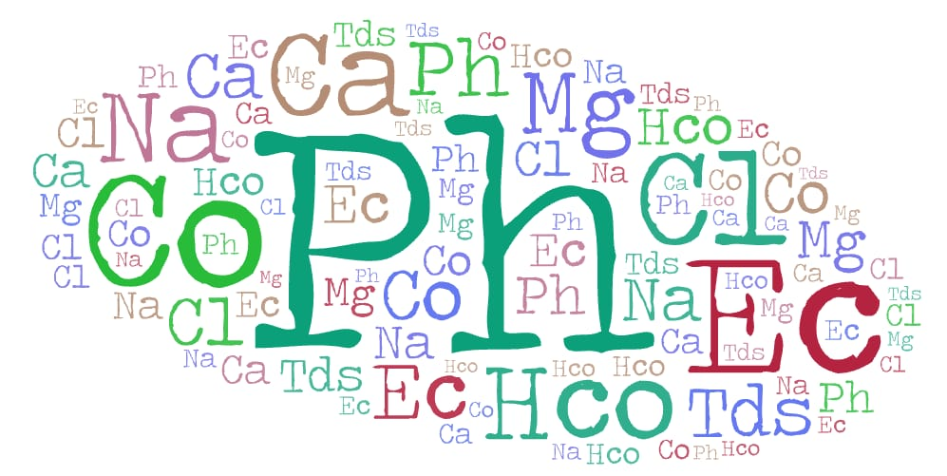
Data Description….
Data
Geographic Variables
District, Latitude and Longitude
Water Parameters
pH, EC, CO3, HCO3, Cl, SO4, NO3, TH, Ca, Mg, Na, K, F and TDS.

Slide 5
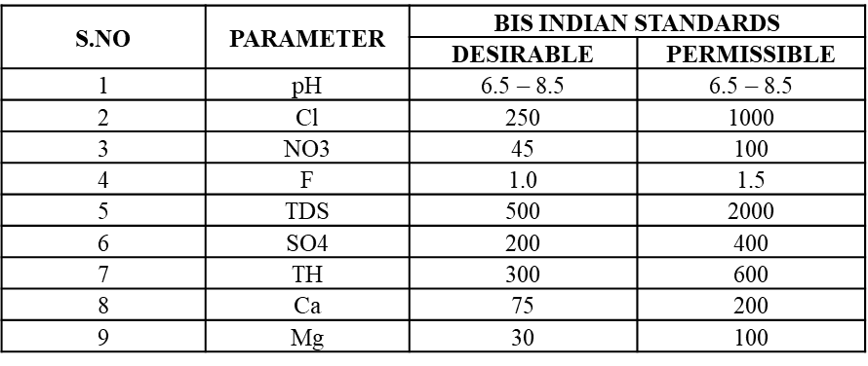
Objectives
To classify groundwater samples (wells) into water quality categories namely desirable, permissible and non-potable.
To predict the water quality categories for years 2020 and 2021, utilizing machine learning algorithms with 2019 data as the training dataset.

Slide 6

To conduct spatial distribution analysis using QGIS software, visualizing the distribution of groundwater quality across different well points.
To investigate factors affecting groundwater quality utilizing the chi-square test.
Industry | Districts
Petrochemical | Tiruvallur, Ranipet and Chennai
Pulp and Paper | Karur
Mining and Smelting | Tuticorin
Chemical Manufacturing | Tiruvallur, Ranipet, Chennai, Tuticorin, Vellore, Salem, Madurai, Kancheepuram and Cuddalore
Distillery | Erode, Sivagangai, Villupuram, Theni. Nellikuppam, Trichy, Tiruppur, Tirunelveli, Kancheepuram and Dharmapuri.
Category | Quantiles
High | Above 75
Moderate | 25 - 75
Low | Below 25

Slide 7

Methods and Models
1
2
3
4
5
RULE BASED CLASSIFICATION
MULTINOMIAL LOGISTIC REGRESSION
RANDOM FOREST CLASSIFIER
GEO SPATIAL ANALYSIS
CHI SQUARE TEST FOR SPATIAL ATTRIBUTES

Slide 8
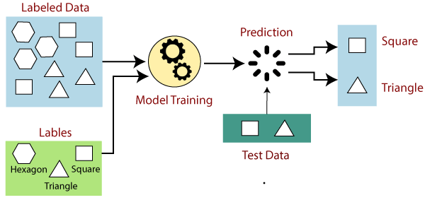
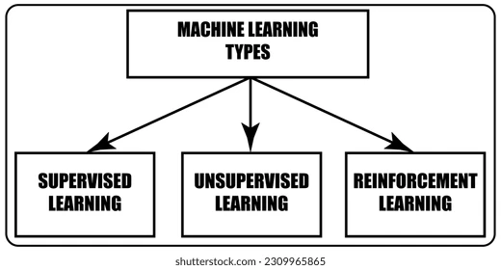
Machine Learning
Supervised Machine Learning
Machine learning is a branch of AI enabling computers to learn from data and make predictions without explicit programming, finding applications for creating intelligent systems and technologies.
In supervised learning, a labelled dataset is used to train the algorithm, and each input data point has a matching target label.

Slide 9


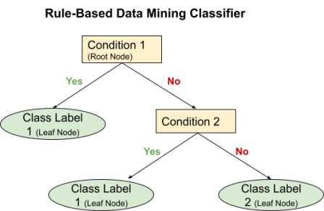
Rule Based Classification
Rule-based classification is a based on a set of predefined rules.
These rules are created manually by domain experts or derived from existing knowledge about the data.

Slide 10
Employed rule – based classification to create the target variable water quality for the year 2019.
Created rules using conditional statements using the BIS limits.
Three categories are desirable, permissible and non – potable.
Desirable | 114 wells
Permissible | 525 wells
Non-potable | 564 wells

Slide 11
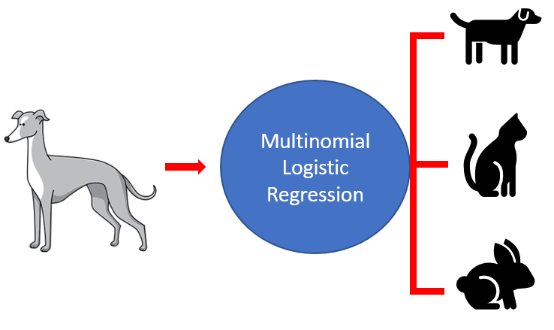
Predicting the Target Variable for the Years 2020 and 2021
Multinomial Logistic Regression
The multinomial logistic regression model (MLRM) is the extension of Logistic Regression, where the response variable can have three or more possible outcomes.
Model is built for the year 2019 data, applying train test algorithm.
Accuracy of the model is 79%.
Water Quality |  | Predicted Values
 |  | desirable | permissible | non-potable
Original Values | desirable | 17 | 15 | 0
 | permissible | 4 | 127 | 23
 | non-potable | 8 | 25 | 135

Slide 12
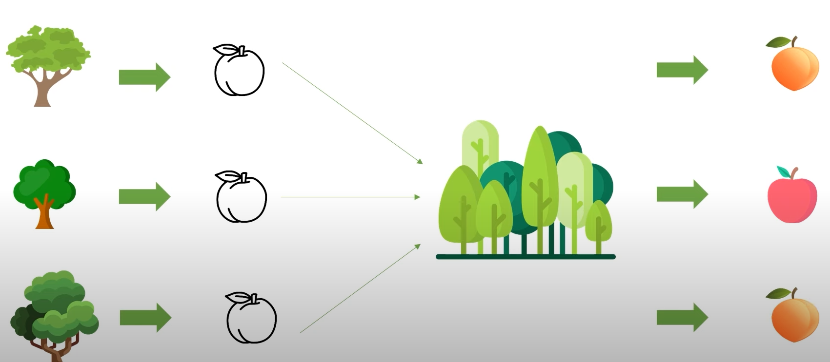
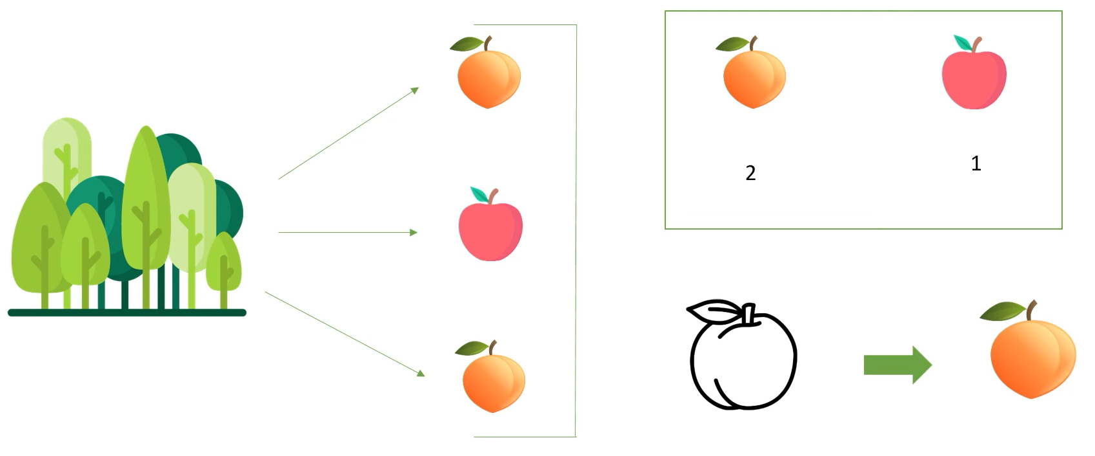
RandomForest Classifier
RandomForest is a supervised machine learning algorithm used in classification and regression problems.
It builds decision trees on different samples and takes their majority vote for classification.
Model is built for the year 2019 data, applying train test algorithm.

Slide 13
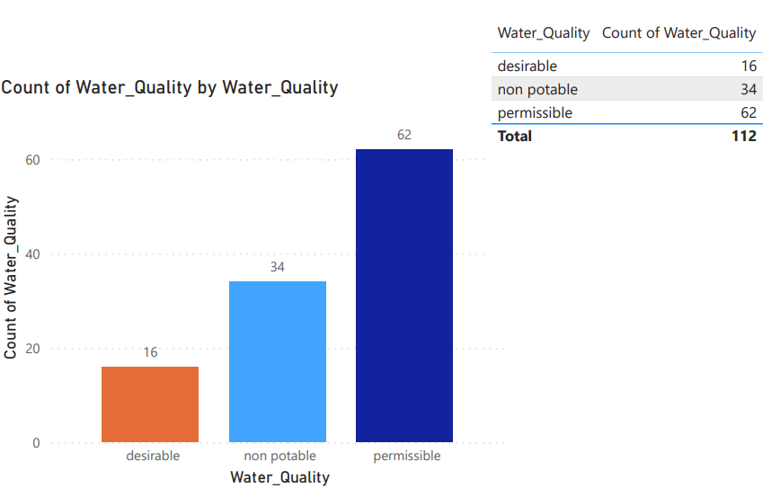
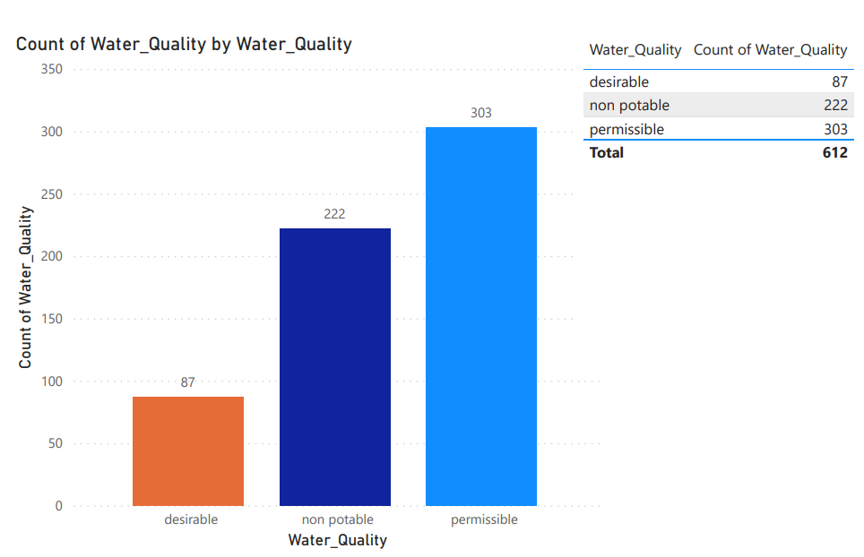
Water Quality |  | Predicted Values
 |  | desirable | permissible | non-potable
Original Values | desirable | 31 | 4 | 1
 | permissible | 2 | 145 | 7
 | non-potable | 2 | 6 | 156
Accuracy of the model is 94%.
Now the model is built for the year 2019 data and predicted the target variable “Water Quality” for the years 2020 and 2021 data.
2020
2021

Slide 14

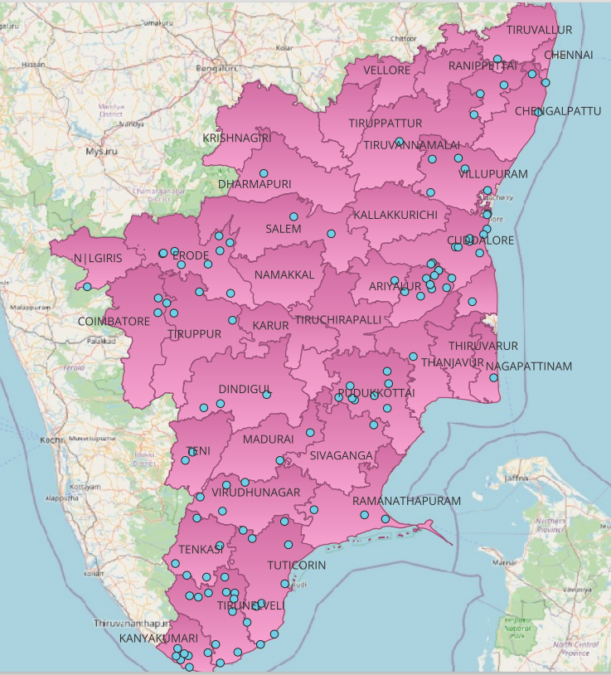
Geo Spatial Analysis
Desirable wells
Geospatial analysis is a method of examining, interpreting, and visualizing data that has a geographic or spatial component.
The distribution of each categories of wells across each districts for the year 2019 data is visualised using Qgis software.

Slide 15
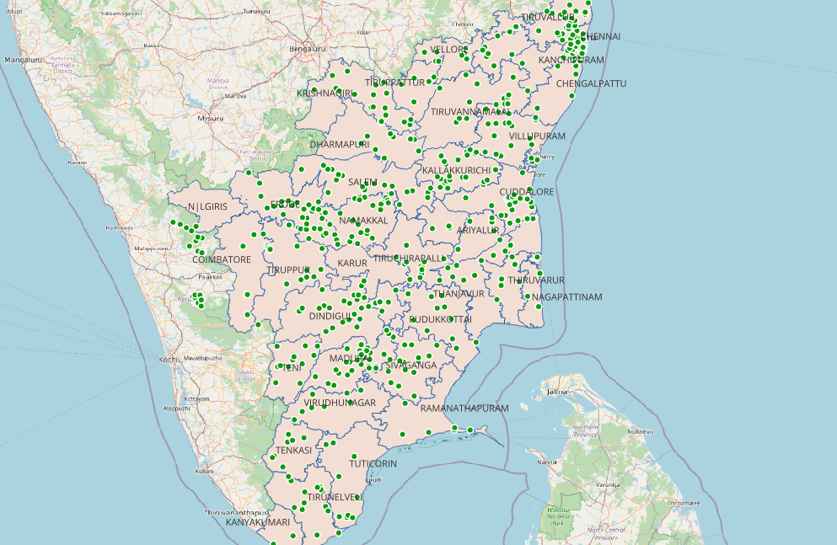
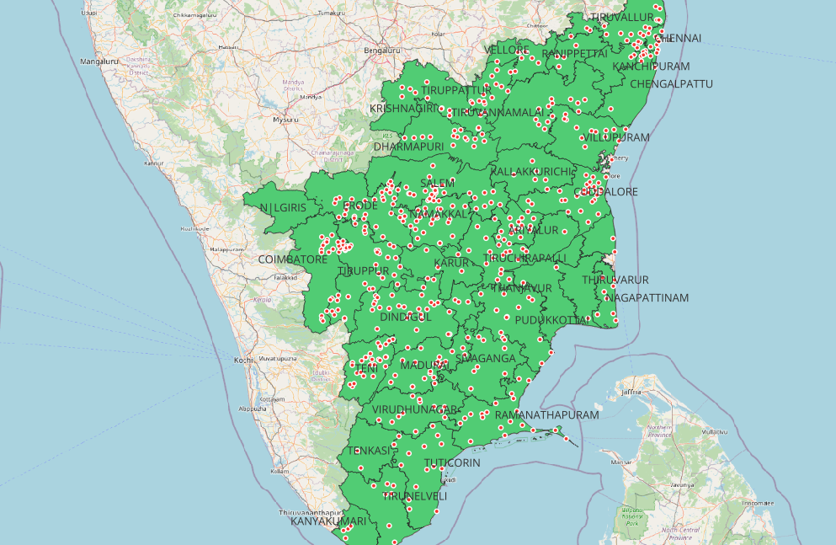
Permissible wells
Non – Potable wells

Slide 16
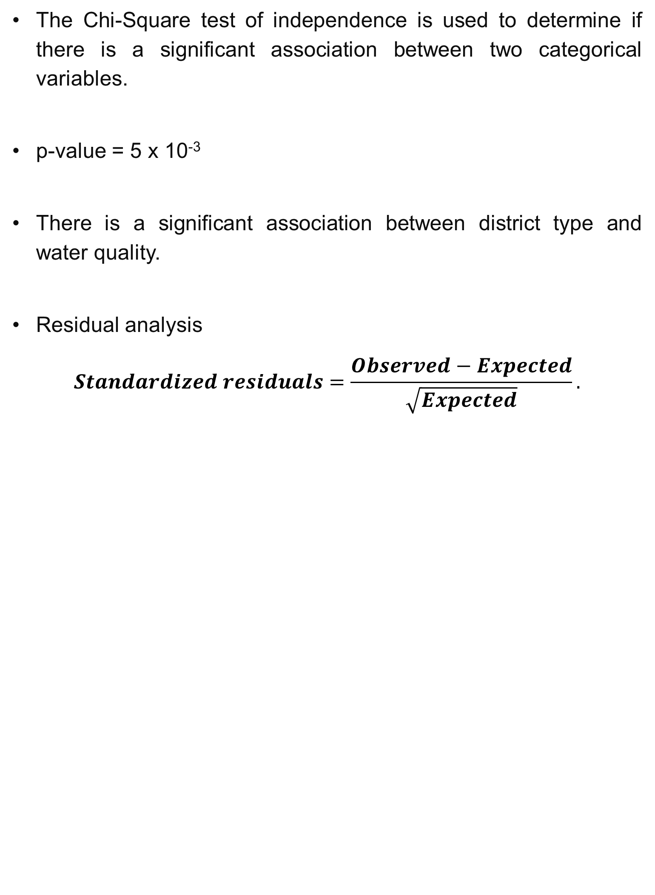
Chi Square Test for Spatial Attributes
Industries
Contingency Table
District type | Water Quality
 | Desirable | Permissible | Non - Potable
Industrial | 64 | 372 | 366
Non - Industrial | 50 | 148 | 177
The Chi-Square test of independence is used to determine if there is a significant association between two categorical variables.
p-value = 5 x 10⁻³
There is a significant association between district type and water quality.
Residual analysis
$$Standardized residuals=\frac{Observed−Expected}{\sqrt{Expected}}.$$
Residuals
District type | Water Quality
 | Desirable | Permissible | Non - Potable
Industrial | -1.55 | 0.94 | -0.21
Non - Industrial | 2.27 | -1.37 | 0.30

Slide 17
Chi Square Test for Spatial Attributes
Bio – Medical Waste
Contingency Table
Bio-medical waste | Water Quality
 | Desirable | Permissible | Non - potable
High | 17 | 133 | 152
Moderate | 27 | 89 | 66
Low | 58 | 269 | 251
p-value = 2 x 10⁻³
There is a significant association between biomedical waste and water quality.
Residuals
Bio-medical waste | Water Quality
 | Desirable | Permissible | Non - potable
High | -2.23 | -0.56 | 1.61
Moderate | 2.28 | 0.53 | -1.60
Low | 0.33 | 0.11 | -0.27

Slide 18
Summary
The water quality of each well is categorised as desirable, permissible and non – potable using rule - based classification for the year 2019 data.
Desirable | 9.69% wells
Permissible | 44.18% wells
Non-potable | 46.13% wells
A multinomial logistic regression model and randomforest classifier model was built for the year 2019 data. The best accuracy model randomforest classifier is chosen.

Slide 19
Summary
The random forest classifier model was utilized to forecast water qualities for the next two years, namely 2020 and 2021.
2020
2021
Desirable | 14.29% wells
Permissible | 55.36% wells
Non-potable | 30.36% wells
Desirable | 14.22% wells
Permissible | 49.51% wells
Non-potable | 36.27% wells
The distribution of wells and their respective water quality classifications has been effectively visualized using QGIS software.

Slide 20
Summary
The chi-square test for association between district type and water quality yielded a significant result with a p-value of 5 × 10⁻³.
Further post hoc residual analysis revealed that industrial areas tend to have a higher frequency of permissible water quality and non-industrial areas exhibit a higher frequency of desirable water quality.
The chi-square test for association between biomed district type and water quality yielded a significant result with a p-value of 2 × 10⁻³.
post hoc residual analysis - The districts with a high amount of biomedical waste tend to have poorer water quality, with less desirable water quality and a higher frequency of non-potable water.
Districts with a moderate amount of biomedical waste exhibit higher frequency of desirable water quality and a lower frequency of non-potable water. Districts with a low amount of biomedical waste do not show significant deviations in water quality.

Slide 21

THANK YOU !!

